Slide 1
EPA Region 6 Air Monitoring and Grants Quality Assurance Program (R6-ARPM)
By: Mark Berry, Environmental Engineer, QA Coordinator, DQM for ARD

Slide 2
Region 6 ARPM Quality Assurance Program
Greetings !!!!
My name is Mark Berry, Environmental Engineer and the Region 6 Quality Assurance (QA) Coordinator for the Air Monitoring and Grants (ARPM) section of the Air and Radiation Division (ARD). I also serve as the primary ARD QA contact
Bio: Mark D. Berry is an Environmental Engineer with a B.S. in Mechanical Engineering with an Environmental Specialty from Southern Methodist University. I have over 23 years of environmental experience serving in both private and governmental roles

Slide 3
U.S. Federal Regulations for quality assurance and control
Why are sound quality assurance and quality control measures essential for scientific integrity?
Accuracy
Accountability
Consistency
Comparability
Traceability
Our Universe: 5 States, 9 Tribes, and multiple local entities included in state grants.

Slide 4
U.S. Federal Regulations for quality assurance and control
What is Quality Assurance and why is it important to the agency?
The Clean Air Act (CAA) and its amendments provide the framework for the protection of air quality. As part of this framework, EPA establishes and periodically revises National Ambient Air Quality Standards (NAAQS) for the criteria pollutants, and the Agency has established requirements for monitoring networks for these pollutants. The QA requirements for ambient air monitoring are located in Title 40 of the Code of Federal Regulations (40CFR) Parts 50, 53, and 58:
The EPA Quality Assurance Program encompasses management and technical activities related to the planning, implementation, assessment and improvement of environmental programs that involve: the collection, evaluation and use of environmental data. the design, construction and operation of environmental technology data
The agency needs high quality data to ensure that all environmental decisions are based on the best quality available
Our program plays a role to ensure that the air monitoring data collected meets the quality standards detailed in the Code of Federal Regulations

Slide 5
U.S. Federal Regulations for quality assurance and control
How do we address QA in Region 6?
40 CFR 58 Appendix A - Quality Assurance Requirements for Monitors used in Evaluations of National Ambient Air Quality Standards. Link: 40 CFR Part 58 Appendix A – Ambient Air Monitoring Quality Assurance Requirements
EPA works closely with our State and local partners
Establish Data Quality Objectives (DQO’s), Monitor Quality Objectives (MQO’s), Data Quality Indicators (DQI’s), Data Certification, Data Validation/Verification, etc.
Technical and Financial Support to Environmental Stakeholders and Partners
Establish an Environment of Continuous Reporting, Assessment, and Improvement

Slide 6
Parts of a US Air Monitoring QA/QC Program
Quality System Requirements for EPA Funded Programs
P1
P2
P3
P4
Planning and Paperwork
Implementation
Assessment
Reports
Guidance Documents, TAD’s, QMP’s, QAPP’s
QAPP Implementation, Internal QC Activities, QC Reports, MQOs, AQS, AQI
Systems Audits TSA’s, Network Reviews, Performance Audits
Data Quality Assessments, Data Quality Indicators DQI’s, QA Reports, Audit Reports

Slide 7
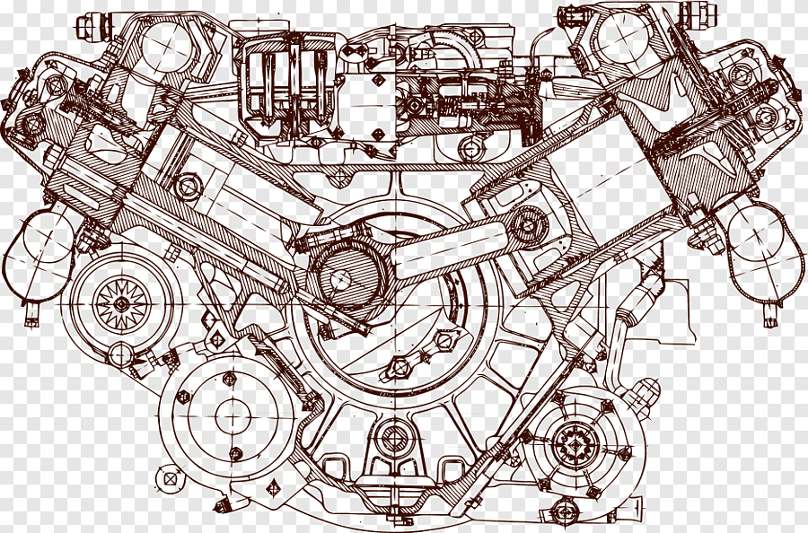
Parts of a US Air Monitoring QA/QC Program
Quality Assurance Project Plan (QAPP)
P1
Planning and Paperwork
The QAPP is your Agency’s specific planning document for conducting a specific monitoring project
It is an overview of your agency’s specific business rules, policies, and quality assurance/ quality control (QA/QC) procedures for conducting the monitoring project
The QAPP is the engine of an air monitoring project
Section 1.0 Pg. 9,10 of 12 QA Handbook II
P2
Implementation
Section 1.0 Pg. 11 of 12 QA Handbook II
P3
Assessment
Section 1.0 Pg. 11 of 12 QA Handbook II
P4
Reports
Section 1.0 Pg. 12 of 12 QA Handbook II

Slide 8
Parts of a US Air Monitoring QA/QC Program
The QAPP is Designed To
P1
Planning and Paperwork
Help improve communications with all staff involved with the monitoring project
Detail responsibilities such that all parties are aware of their roles within the project
The QAPP can serve as both a training guide and legacy document
A QAPP is required for all EPA funded projects where data collection is involved
Section 1.0 Pg. 9,10 of 12 QA Handbook II
P2
Implementation
Section 1.0 Pg. 11 of 12 QA Handbook II
P3
Assessment
Section 1.0 Pg. 11 of 12 QA Handbook II
P4
Reports
Section 1.0 Pg. 12 of 12 QA Handbook II

Slide 9
Parts of a US Air Monitoring QA/QC Program
Before you Start Your QAPP
P1
Planning and Paperwork
The QAPP is NOT a guidance document
The QAPP is a complete picture of how a specific project will be planned, implemented, evaluated, and reported by your agency
The QAPP writer should have access to 40 CFR Parts 50,53, and 58 as well as EPA guidance documents when preparing the QAPP
The QAPP MUST be written and approved before monitoring commences
Section 1.0 Pg. 9,10 of 12 QA Handbook II
P2
Implementation
Section 1.0 Pg. 11 of 12 QA Handbook II
P3
Assessment
Section 1.0 Pg. 11 of 12 QA Handbook II
P4
Reports
Section 1.0 Pg. 12 of 12 QA Handbook II

Slide 10
Parts of a US Air Monitoring QA/QC Program
QAPP Structure Overview
P1
Planning and Paperwork
Typically, there are 24 Elements to a given QAPP.
However, EPA does provide some flexibility based on a graded approach to the QAPP category. Environmental Data Objectives (EDO’s)
Category I – EDO’s Directly Support Rule Making, Enforcement, Regulatory or Policy Decisions (Formal DQO’s)
Category II – EDO’s Support other Projects in Support of Rule Making, Regulatory, and Policy Decisions (Formal DQO’s for National Objectives, Flexible DQO’s for Local Objectives)
Category III – EDO’s Perform as Interim Steps in a Larger Group of Operations, One Time Studies on a Local Scale (Flexible DQO’s)
Category IV – EDO’s to Study Basic Phenomena or Issues, Education and Outreach (Project Objectives and Goals)
EPA Air Monitoring QAPP Checklist is a Great Tool to ensure All Necessary Elements are addressed in each QAPP
Section 1.0 Pg. 9,10 of 12 QA Handbook II
P2
Implementation
Section 1.0 Pg. 11 of 12 QA Handbook II
P3
Assessment
Section 1.0 Pg. 11 of 12 QA Handbook II
P4
Reports
Section 1.0 Pg. 12 of 12 QA Handbook II

Slide 11
Parts of a US Air Monitoring QA/QC Program
Elements of a QAPP
P1
Planning and Paperwork
Section 1 – 9 discuss project management
Section 2 – Table of contents
Section 3 – Distribution list
Section 4 – Project / Tack Organization
Section 5 – Problem Definition and Background
Section6 – Project Task / Description
Section 7 – Quality Objectives and Criteria for Measurement
Section 8 – Training
Section 9 – Document and Records
Section 10 – Network Description
Section 11 – Sampling Method Requirements (Field Work)
Section 12 – Sample Handling and Custody
Section 13 - Analytical Methods (Lab Work)
Section 14 – Quality Control Requirements
Section 15 – Instrument / Equipment Testing, Inspection, and Maintenance Requirements
Section 16 – Instrument Calibration Frequency
Section 17 - Inspection Acceptance Requirements for Supplies and Consumables
Section 18 – Non-Direct Measurements
Section 19 – Data Management
Section 20 – Assessment and Response Actions
Section 21- Reports and Management
Section 22 – Data Validation and Useability
Section 22 – Data Validation Methods
Section 23 – Validation and Validation Methods
Section 24 – Reconciliation with Data Quality Objectivity
Section 1.0 Pg. 9,10 of 12 QA Handbook II
P2
Implementation
Section 1.0 Pg. 11 of 12 QA Handbook II
P3
Assessment
Section 1.0 Pg. 11 of 12 QA Handbook II
P4
Reports
Section 1.0 Pg. 12 of 12 QA Handbook II

Slide 12
Parts of a US Air Monitoring QA/QC Program
Project Assessment Goals
P1
Planning and Paperwork
Assessments are evaluation processes used to measure the performance or effectiveness of the system and its elements.
Network Reviews - The network review is used to determine how well a particular air monitoring network is achieving its required air monitoring objective(s) and how it should be modified to continue to meet its objective(s)
Systems Audits (TSA’s) - A TSA is an on-site review and inspection of a monitoring organizations ambient air monitoring program to assess its compliance with established regulations governing the collection, analysis, validation, and reporting of ambient air quality data.
40 CFR Part 58 Appendix A section 2.5 describes TSAs performed by the EPA Regional Offices
Both EPA and monitoring organizations perform TSAs
Primary Quality Assurance Organizations (PQAO’s) are audited on a 3-year cycle
Local and Tribal Programs are audited on a 6-year cycle
Section 1.0 Pg. 9,10 of 12 QA Handbook II
P2
Implementation
Section 1.0 Pg. 11 of 12 QA Handbook II
P3
Assessment
Section 1.0 Pg. 11 of 12 QA Handbook II
P4
Reports
Section 1.0 Pg. 12 of 12 QA Handbook II

Slide 13
Parts of a US Air Monitoring QA/QC Program
Project Assessment Goals
P1
Planning and Paperwork
Assessments are evaluation processes used to measure the performance or effectiveness of the system and its elements.
Performance Audits - Performance evaluations are a type of audit in which the quantitative data generated in a measurement system are obtained independently and compared with routinely obtained data to evaluate the proficiency of an analyst, laboratory, or measurement system. National Performance Audit Program (NPAP) and Performance Evaluation Program (PEP) Audits
20% of every Air Monitoring Program Monitors are audited each year. 100% of all monitors in the region are required to be audited within 5 years
Some PQAO’s opt out of the federal NPAP/PEP auditing program and perform their own performance audits. TCEQ is one of those programs
Section 1.0 Pg. 9,10 of 12 QA Handbook II
P2
Implementation
Section 1.0 Pg. 11 of 12 QA Handbook II
P3
Assessment
Section 1.0 Pg. 11 of 12 QA Handbook II
P4
Reports
Section 1.0 Pg. 12 of 12 QA Handbook II

Slide 14
Parts of a US Air Monitoring QA/QC Program
EPA Audit Programs
P1
Planning and Paperwork
TSA Audit requirements for US air monitoring programs
NPAP/PEP requirements for US air monitoring programs
Performance evaluation requirements for US air monitoring programs
Corrective action program procedures for air monitoring programs in Region 6
Section 1.0 Pg. 9,10 of 12 QA Handbook II
P2
Implementation
Section 1.0 Pg. 11 of 12 QA Handbook II
P3
Assessment
Section 1.0 Pg. 11 of 12 QA Handbook II
P4
Reports
Section 1.0 Pg. 12 of 12 QA Handbook II

Slide 15
U.S. Federal Regulations for quality assurance and control (Resources)
Agency Wide Quality Systems Documents (Very General) https://www.epa.gov/quality/agency-wide-quality-program-documents
Ambient Monitoring Technology Information Center (AMTIC) (Specific to Air Monitoring Programs) https://www.epa.gov/amtic
QA Handbook Volume II - Air Monitoring Handbook II
Volume II is dedicated to the Ambient Air Quality Surveillance Program and the data collection activities inherent to that program. The Air Monitoring Handbook II is part of a quality management system designed to ensure that the Ambient Air Quality Surveillance Program: (1) provides data of sufficient quality to meet the program’s objectives, and (2) is implemented consistently across the Nation. The purpose of the Handbook is twofold
Link: https://www.epa.gov/sites/production/files/2020-10/documents/final_handbook_document_1_17.pdf
Guide to Writing Quality Assurance Project Plans for Ambient Air Monitoring Networks
A Quality Assurance Project Plan, or QAPP, is a written document outlining the procedures a monitoring project will use to ensure the data it collects and analyzes meets project requirements. ... By law, any EPA-funded monitoring project must have an EPA-approved QAPP before it can begin collecting samples
https://www.epa.gov/sites/production/files/2020-10/documents/air_monitoring_qapp_guide_-_final.pdf

Slide 16
U.S. Federal Regulations for quality assurance and control (Resources)
Additional Resources
Newsletters
EPA periodically publishes a newsletter providing National QA program updates and other ambient air monitoring QA related news
Copies of the current and past newsletters can be found at the following link: Ambient Air Monitoring QA Newsletter
EPA’s QA Training is now available online:

Slide 17
U.S. Federal Regulations for quality assurance and control (Resources)
Additional Resources
(QA) ONLINE TRAINING FOR GRANTEESS AND NON-EPA QA STAFF
Region 6 (R6) Laboratory Services and Applied Science Division provides a Computer-Generated Quality Assurance (QA) Training for Grantees and non-EPA R6 QA employees! It details the requirements for conducting quality management activities for environmental data collection and environmental technology programs performed by or for the Agency.
Note, R6 QA staff are also electronically notified once someone completes the training! The revamped training is in lieu of the previously offered four-day classroom training, and thus will be considered as equivalent. You can access the training by clicking on the following link: https://www.epa.gov/quality/r6-qa-training-grantees-and-other-qa-personnel .

Slide 18
U.S. Federal Regulations for quality assurance and control
Contact Us
Theresa Alexander – Section Chief, Air Monitoring and Grants Program
Phone – (214) 665-8571
E-Mail – Alexander.theresa@epa.gov
Mark Berry – Quality Assurance Coordination, Corrective Action, Data Certifications, QAPP and QMP Review,
Phone - (214) 665-3183
E-Mail - Berry.mark@epa.gov
David Anderson – Technical Systems Audits Coordinator, Data Management
Phone – (214) 665-6512
E-Mail - Anderson.David@epa.gov
Clarence Jackson – NPAP and PEP Programs
Phone – (281) 983-2171
E-Mail - Jackson.Clarence@epa.gov

Slide 19
U.S. Federal Regulations for quality assurance and control
Questions

