Slide 1
TCEQ Air Monitoring Quality Assurance Overview
Texas Commission on Environmental Quality
Stephanie Ma, Ambient Monitoring Section Manager

Slide 2
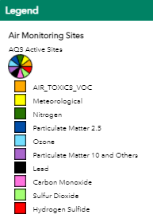
The Texas air monitoring network consists of roughly 230 monitoring stations with over 500 individual pollutant samplers. Over half of the network is owned and operated by the TCEQ.

Slide 3
Compounds of Interest
Six criteria pollutants:
Ozone
Carbon monoxide
Nitrogen Dioxide
Sulfur Dioxide
Lead
Particulate matter
Particulate matter less than 10 micrometers in diameter (PM₁₀)
Particulate matter less than 2.5 micrometers in diameter (PM_{2.5})
Robust network of state-initiative monitoring that also includes:
Volatile organic compounds (VOCs)
Hydrogen sulfide

Slide 4
Quality Assurance Overview
Quality system implementation
Siting criteria
Monitoring equipment
Data validation
Audits

Slide 5
Quality System Implementation
Quality Management Plan
Quality Assurance Project Plans
Standard Operating Procedure (SOPs)
Personnel Qualifications and Training
Documentation
Notes:
Operator logs and chain of custody forms
Quality control records
Data validation records
Training Records

Slide 6
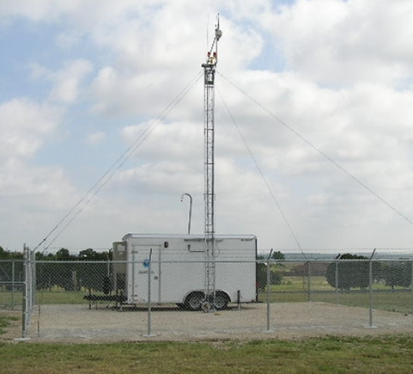
Siting Criteria – evaluated during initial site selection and annually thereafter
Sampler monitoring objective
Parameter specific
Federal siting criteria requirements
Distance from trees, obstructions, and roadways
Unrestricted air flow
Probe height and material

Slide 7
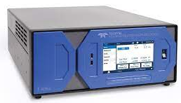
Monitoring Equipment
TCEQ uses federal reference method (FRM) or federal equivalent method (FEM) monitoring equipment for criteria pollutants
Equipment must be operated according to the manufacturer’s specifications
Preventive maintenance
Operating conditions such as temperature and humidity
Quality control (QC) checks
Flow checks
Equipment comparisons and test plans

Slide 8
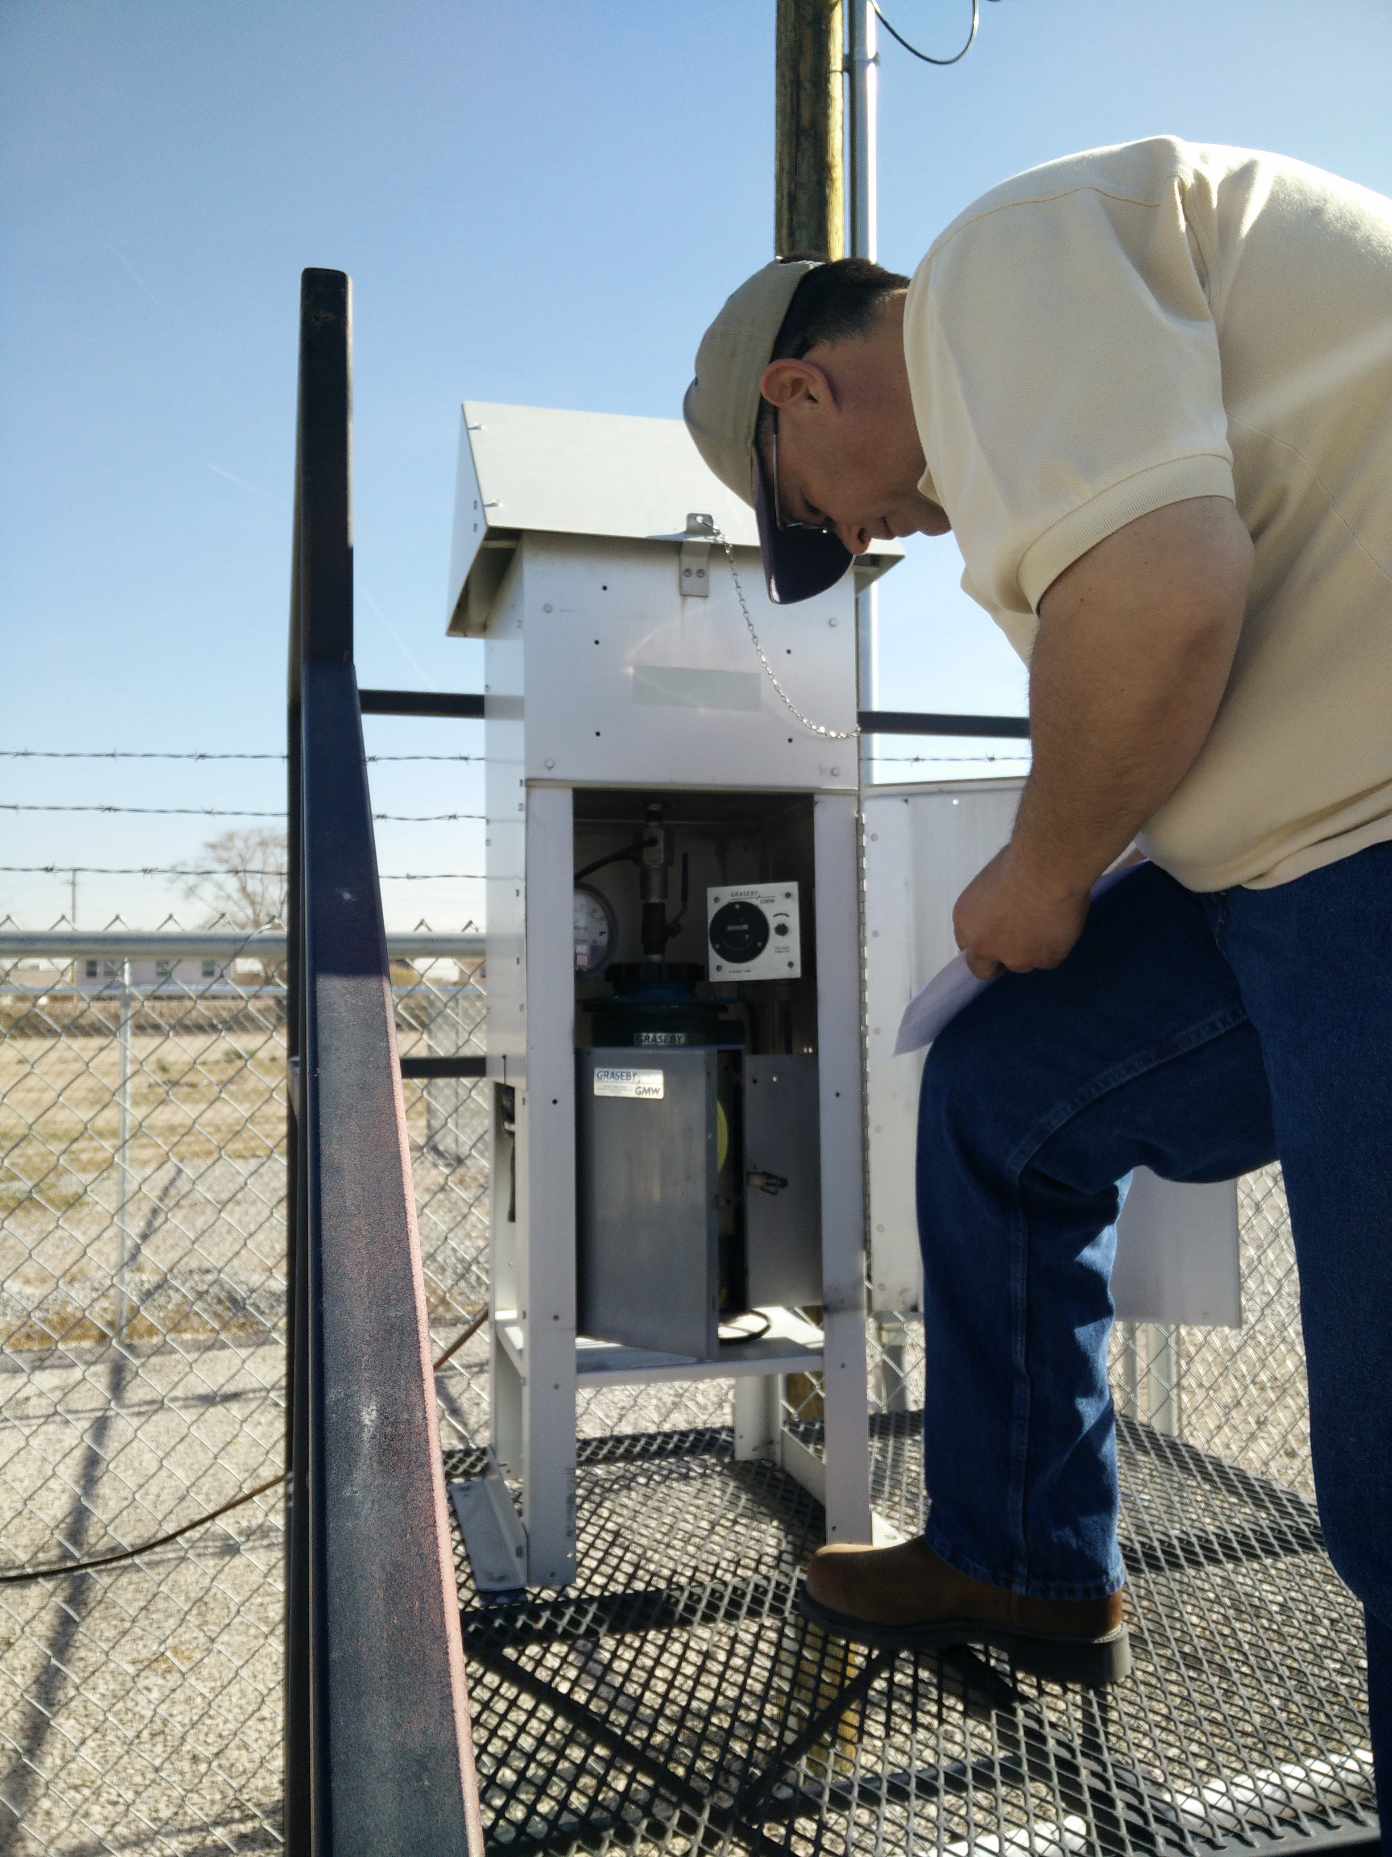
Field Quality Control Checks
Automated daily, weekly, and monthly checks on the continuous gaseous analyzers
Calibrations and monthly verification checks for PM equipment

Slide 9
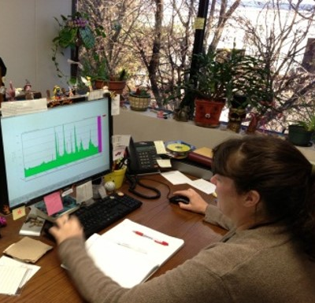
Data Validation
QC data review
Bracketing data
Cross-site comparisons
Identifying anomalies
Site documentation

Slide 10
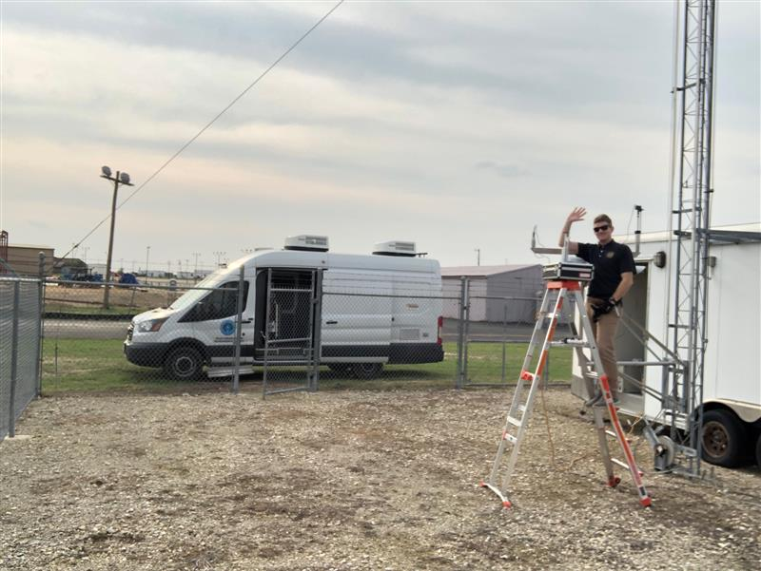
Audits
Field audits
Flow, temperature, and pressure audits
Laboratory control checks
Performance evaluation (PE) audits
Technical systems audits

Slide 12
Questions?
Stephanie Ma, Manager
Ambient Monitoring Section
512-239-6256
Stephanie.ma@tceq.texas.gov

