Slide 1

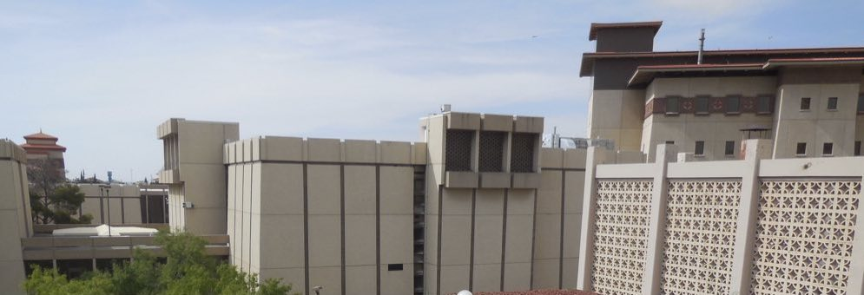

New Chemical Approaches for
Air Quality Modeling
– TCEQ Presentation August, 22, 2023 –
William R. Stockwell
Rosa M. Fitzgerald
University of Texas at El Paso

Slide 2
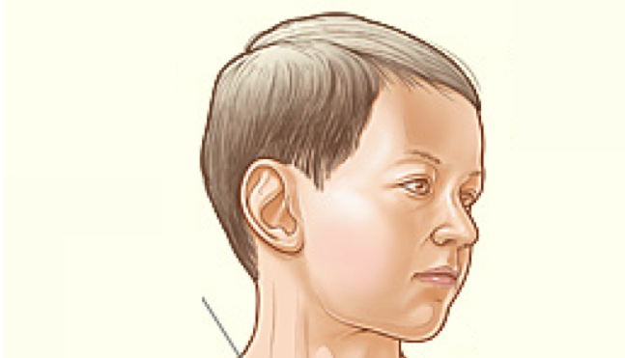
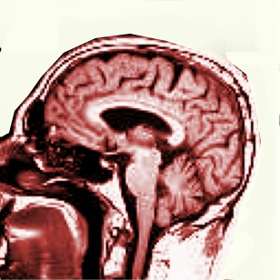

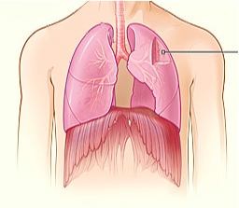
Why Do We Care?
Brain
O₃, PM_{2.5} PM₁₀
Ozone and Particulate Matter (PM_{2.5} and PM₁₀) are inhaled.
O₃ may inflame lung linings.
PM_{2.5} may lodge in the lungs and may travel to the heart and brain where they can cause more damage.
Lungs
Heart
2

Slide 3
The Atmospheric System
3

Slide 4
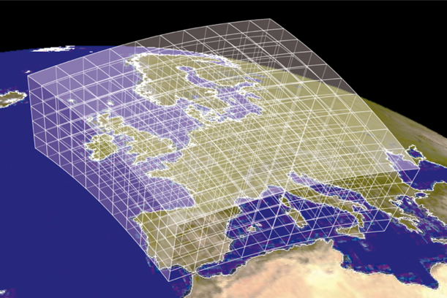
Eulerian Grid Models for Air Quality
Numerical Complexity Increases with Number of Modeled Pollutants
A Very Large Number of Grid Boxes
4

Slide 5
Air Quality Model Modules
5

Slide 6
Tropospheric O₃ Chemistry
Sun
O₃ Formation
NO₂ + hν → O(³P) + NO
O(³P) + O₂ (+ M) → O₃ (+ M)
Ozone Destruction
NO + O₃ → NO₂ + O₂
Steady-State Ozone Concentrations
d[NO]/dt = J[NO₂] - k[NO][O₃] ≅ 0
[O₃] = {J / k} {[NO₂] / [NO]}
6

Slide 7
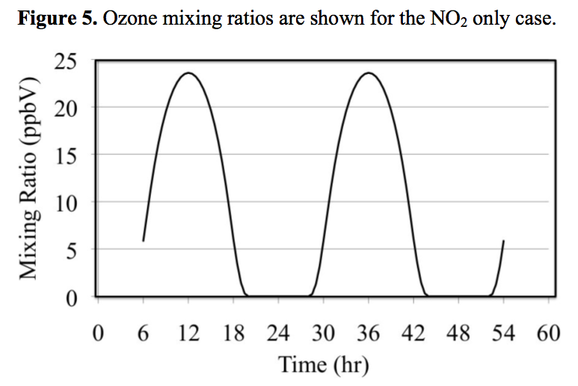
Tropospheric Ozone Concentrations
for Air Polluted by NO and NO₂ Only.
7

Slide 8
HO Radical Production
Sun
O₃ + hν → O(¹D) + O₂
O(¹D) + N₂ → O(³P) + N₂
O(¹D) + O₂ → O(³P) + O₂
O(³P) + O₂ (+ M) → O₃ (+ M)
O(¹D) + H₂O → 2 HO•
8
8

Slide 9
Alkane Oxidation
HO• + CH₃CH₃ → H₂O + CH₃CH₂•
CH₃CH₂• + O₂ → CH₃CH₂O₂•
CH₃CH₂O₂• + NO → CH₃CH₂O• + NO₂
CH₃CH₂O• + O₂ → CH₃CHO + HO₂•
HO₂• + NO → HO• + NO₂
Conversion of NO to NO₂ produces O₃
9

Slide 10
Photolysis of Ozone, Nitrogen Dioxide and Reactions of Organic Gases are Key to Ozone and Aerosol Production
hν
+ SO₂
Aq. Chem
Inorganic
Aerosol
Secondary
Organic Aerosol
+ NH₃
hν
10

Slide 11
NO_{x} and VOC Dependence
11

Slide 12
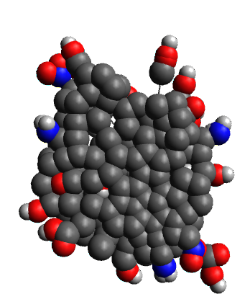
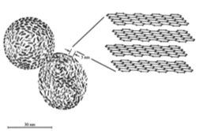
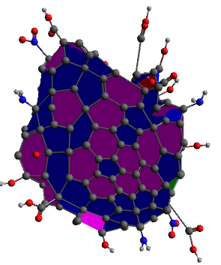
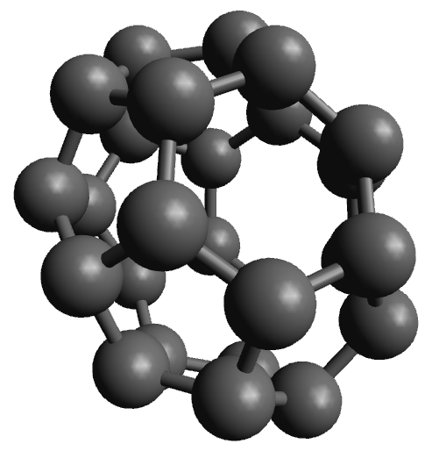
Soot and Secondary Organic Aerosol (SOA)
are Major Health Concerns
Computational Models of Soot
Note reactive sites (Red and Blue) that may influence health effects.
Soot
Note the similarity to carbon nanostructures.
26-Fullerene
Polanco, Ramos, Fitzgerald and Stockwell, An Improved Method for Optical Characterization of Mineral Dust and Soot Particles at the El Paso-Juárez Airshed, Atmosphere, 11, 866, 2020. https://doi.org/10.3390/atmos11080866
12

Slide 13
Eulerian Air Quality Models, Meteorology and Processes
Examples of Widely Used Models
Meteorological Models
WRF: Weather Research
& Forecasting Model
Emissions Modeling Platforms
SMOKE: Sparse Matrix Operator Kernel Emissions
Air Quality Models
CMAQ: The Community Multiscale
Air Quality Modeling System
CAMx: Comprehensive Air Quality
Model with Extensions (CAMx)
WRF-Chem
Health / Ecomomic Effects Models
BINMAP-CE: Environmental Benefits Mapping and Analysis Program - Community Edition (BenMAP-CE)
13

Slide 14
Balance the Treatment of
Meteorological and Chemical Processes in Eulerian Air Quality Models
Use Practical Mechanisms for Modeling Air Quality
Use complete enough chemistry to describe the air quality situation but multi-million reaction mechanisms will not improve the accuracy of air quality simulations.
Multi-Phase Chemistry
A closer coupling of gas-phase and aerosol processes in models should improve gas-phase & secondary particulate matter simulations.
14

Slide 15
RADM / RACM / CRACMM Series
1990
Regional Acid Deposition Mechanism, version 2 (RADM2)
1997
Regional Atmospheric Chemistry Mechanism (RACM)
2013
Regional Atmospheric Chemistry Mechanism, version 2 (RACM2)
2023
Community Regional Atmospheric Chemistry Multiphase Mechanism (CRACMM)
Expected to Become CMAQ Default
15

Slide 16
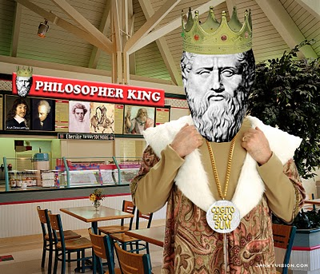
RADM / RACM / CRACMM
Series Design Philosophy
Provide a more detailed description of background and low NO_{x} atmospheric chemistry than available in urban scale mechanisms during the early 1980s. Example: avoid operator approaches to peroxy-radicals.
Multi-day scenarios need to be simulated. Day/Nighttime chemistry important.
Limit VOC detail to describe VOCs in the emissions inventories. Why have many more stable VOC species in the mechanism than available in the inventory?
Provide a chemical mechanism compact enough (numbers of reactions and species) so that it can run in Eulerian Air Quality Models. But size may range toward the upper bound.
Use sensitivity and uncertainty analysis as guides in mechanism development.
16

Slide 17
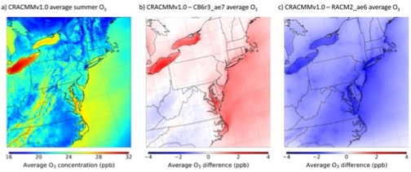
New CRACMM
New CRACMM in CMAQ vs Older Mechanisms
CRACMMv1.0 Average Summer O₃
CRACMMv1.0 – CB6r3 Average O₃
CRACMMv1.0 – RACM2 Average O₃
16 20 24 28 32
-4 -2 0 + 2 +4
-4 -2 0 + 2 +4
Average O₃ Concentration (ppb)
Average O₃ Difference (ppb)
Average O₃ Difference (ppb)
17

Slide 18
New CRACMM
Example of Using Models to
Evaluate Control Stratagies
The Los Angeles South Coast Air Basin
18

Slide 19
Key Research Questions for
Coordinating Research Council Los Angeles Study
New CRACMM
The California Air Resources Board (ARB) and the South Coast Air Quality Management District (SCAQMD) have developed Emissions Reduction Plans for the South Coast Air Basin (SoCAB) to reduce Ozone and Particulate Matter Concentrations by the year 2030.
The plan focuses heavily on the reduction of nitrogen oxide (NO_{x}) emissions.
Will the plan work for Particulate Matter?
The Community Multi-scale Air Quality model was used to simulate two high PM episodes for 2008 and 2030.
19

Slide 20
New CRACMM
Simulated 24-hr Average PM_{2.5}
November 20, 2008 – Aerosol Season, Example Day
Micrograms m⁻³
20

Slide 21
New CRACMM
CMAQ Simulated 24-hr average PM_{2.5} Concentrations SoCAB November 20, 2030 – Aerosol Season
Planned NO_{x} Reductions
21

Slide 22
New CRACMM
Simulated particulate matter mass concentrations by component for 2008 and 2030 – Anaheim
Course Mass
Anaheim
Unidentified PM2.5
Ammonium Sulfate
Concentration μm⁻³
Ammonium Nitrate
Elemental Carbon
Biogenic SOA
Anthropogenic SOA
Primary Organic Matter
22

Slide 23
New CRACMM
SoCAB Health
and
Economic Effects
Environmental Benefits Mapping and Analysis Program – Community Edition
23

Slide 24
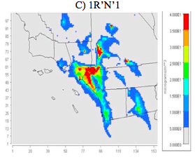
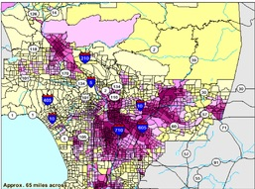
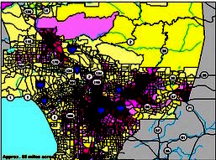
Determine Air Quality Surfaces
Steps and the input data files required to run BenMAP-CE.
New CRACMM
Control case
Base case
Change in air quality
Difference between base case and future-year control case.
Health Impact Calculations
Population Data
Incidence Rates
Change in exposed population between base case and future-year control year case.
Health Impact Functions
Change in
adverse health effects incidence.
Economic Cost and Benefits
Valuation Functions
Economic value of change in air quality.
Reporting
Results: Maps, Tables, etc.
24

Slide 25
New CRACMM
Estimated Avoided PM_{2.5} Related 2030 Mortalities for Six VOC and NO_{x} Emission Reduction Scenarios in the SoCAB
25

Slide 26
New CRACMM
Total monetized health benefits for all avoided PM2.5 related health impacts for the six VOC and NOx emission reduction scenarios in the SoCAB region.
26

Slide 27
New CRACMM
SoCAB Air Quality Model Simulation Conclusions
Ammonium nitrate was the most abundant secondary aerosol component and its production is a very nonlinear function of both NO_{x} and VOC emissions.
The emissions control strategy of the California Air Resources Board reduces PM_{2.5} exposure and would save $6.6 Billion dollars compared with 2008.
But the 2030 target emissions control strategy is the least effective in reducing PM_{2.5} concentrations and improving health of the six future-year cases simulated.
Published: Stewart, D.R., E. Saunders, R. Perea, R. Fitzgerald, D.E. Campbell, W.R. Stockwell, J. Air and Waste Management Association, 69, 192–208, 2019.
Stewart, D.R., E. Saunders, R.A. Perea, R. Fitzgerald, D.E. Campbell and W.R. Stockwell, Environmental Health Insights, 11, 1-13, 2017.
27

Slide 28
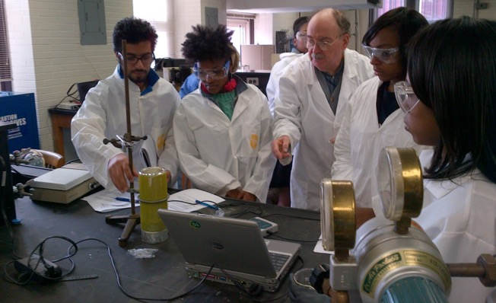
A Diverse and Balanced Community
Maintain a diverse community of scientists. Diverse in terms of sex, race, culture and scientific discipline (e.g. more applied mathematicians are desperately needed).
A diverse community should provide new approaches and provide an important check on mainstream trends. – Reduce groupthink.
Greater mixing between atmospheric chemists, air quality modelers and policy makers would encourage greater balance in all three areas.
28

Slide 29
Acknowledgement
Thank You for Your Support!
29

