Slide 1

TCEQ Air Monitoring Quality Assurance Field Activities
Texas Commission on Environmental Quality
Neal Penney, Network Operations Section Manager

Slide 2


Compounds of Interest
Six criteria pollutants:
  Ozone
  Carbon monoxide
  Nitrogen Dioxide
  Sulfur Dioxide
  Lead
  Particulate matter
    Particulate matter less than 10 micrometers in diameter (PM₁₀)
    Particulate matter less than 2.5 micrometers in diameter (PM_{2.5})
Robust network of state-initiative monitoring that also includes:
    Volatile organic compounds (VOCs)
    Hydrogen sulfide
Notes:
Reminder of what TCEQ monitors for within our network.

Slide 3
Quality Assurance Overview
Quality system implementation
Siting criteria
Monitoring equipment
Audits

Slide 4
Quality System Implementation
Quality Management Plan
Quality Assurance Project Plans
Standard Operating Procedure (SOPs)
Personnel Qualifications and Training
Documentation
Notes:
Quality Management Plan and Quality Assurance Plans – updated by management with input from field staff
SOPs are developed by equipment techs in shop but then updated by operators in the field. SOPs are updated every two years, largely with information provided by field operators.
Each operator must perform a competency demonstration before they are allowed to operate by themself.
All of this is documented in operator logs and performance plans

Slide 5
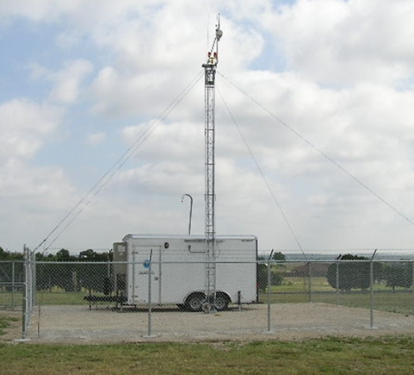
Siting Criteria – evaluated during initial site selection and annually thereafter
Federal siting criteria requirements, found in 40 CFR Part 58, Appendix E
Distance from trees, obstructions, and roadways
Unrestricted air flow
Probe height and material

Slide 6

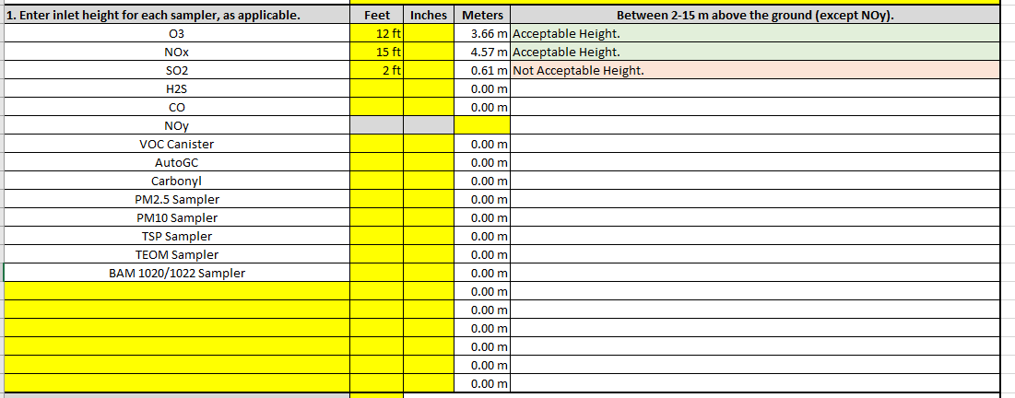
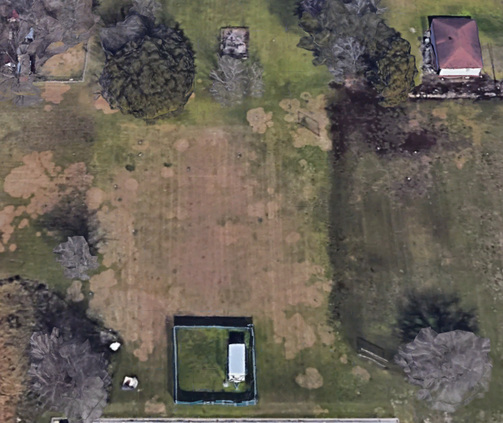


Siting Criteria
Developed a spreadsheet to help make it easy for operators to evaluate all siting criteria requirements.
Things around a site can change from year to year.
Notes:
TCEQ developed a spreadsheet to assist with evaluating siting criteria each year.
NOS holds annual trainings for operators.
Siting criteria is a topic that is always discussed, if issues are found. TCEQ works with property owner to trim trees if they encroach on our site.
Siting criteria is also audited by Cal Lab staff when they perform PE audits at the site.

Slide 7
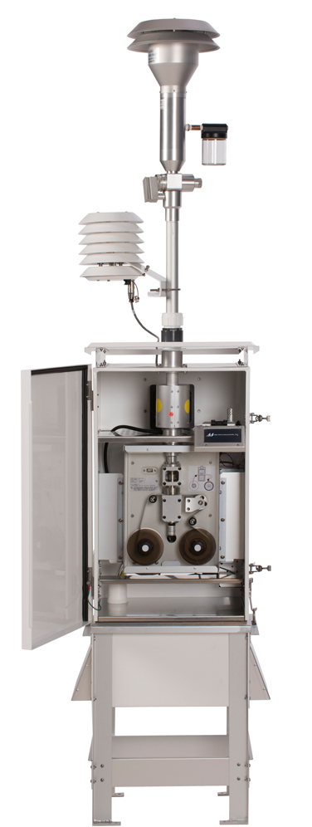
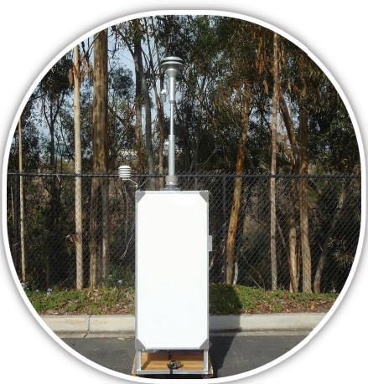
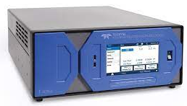
Monitoring Equipment
TCEQ uses federal reference method (FRM) or federal equivalent method (FEM) monitoring equipment for criteria pollutants
Equipment must be operated according to the manufacturer’s specifications
  Preventive maintenance
  Quality control (QC) checks
    Automated nightly, weekly, and monthly QC checks
    Flow checks
Notes:
TCEQ uses same equipment at each site.
This is beneficial for such a geographically diverse network.
Primary Teledyne API and Sabio for gaseous parameters, this helps with limiting number of SOPs, field operators are familiar with all equipment, and could work at any site across Texas.
Teledyne API, MetOne, and Thermo for PM2.5
Tisch for PM10
Even though the calibrators are from different manufacturers, they are set up the same
Gas standard port assignments are the same
SOPs for both types are organized the same with only differences in menu the operator would encounter.

Slide 8
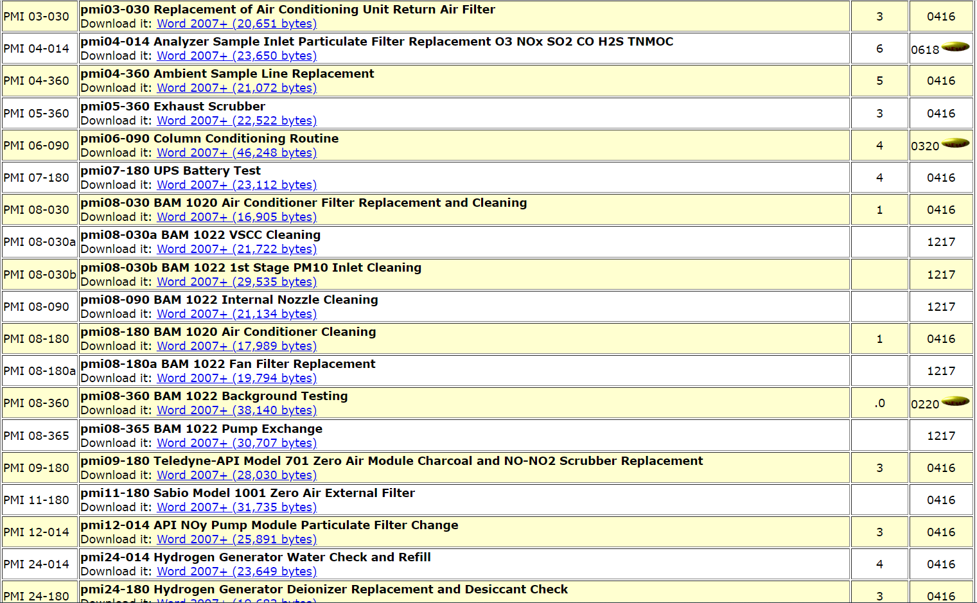
Preventive Maintenance
TCEQ has an electronic preventive maintenance manual that operators can access at all sites.
The PMI manual is updated when new equipment is added to the network or as needed.
All preventive maintenance is listed in Standard Operating Procedures (SOPs) for each piece of equipment.
Preventive maintenance instructions also included for upkeep of shelters.
Notes:
Operators are encouraged to provide feedback on preventive maintenance procedures.
Upkeep of shelters is important for maintaining proper temps. Includes HVAC filter changes, testing of battery backups, and electrical outlets.
We also have a site safety checklist that is performed monthly.

Slide 9
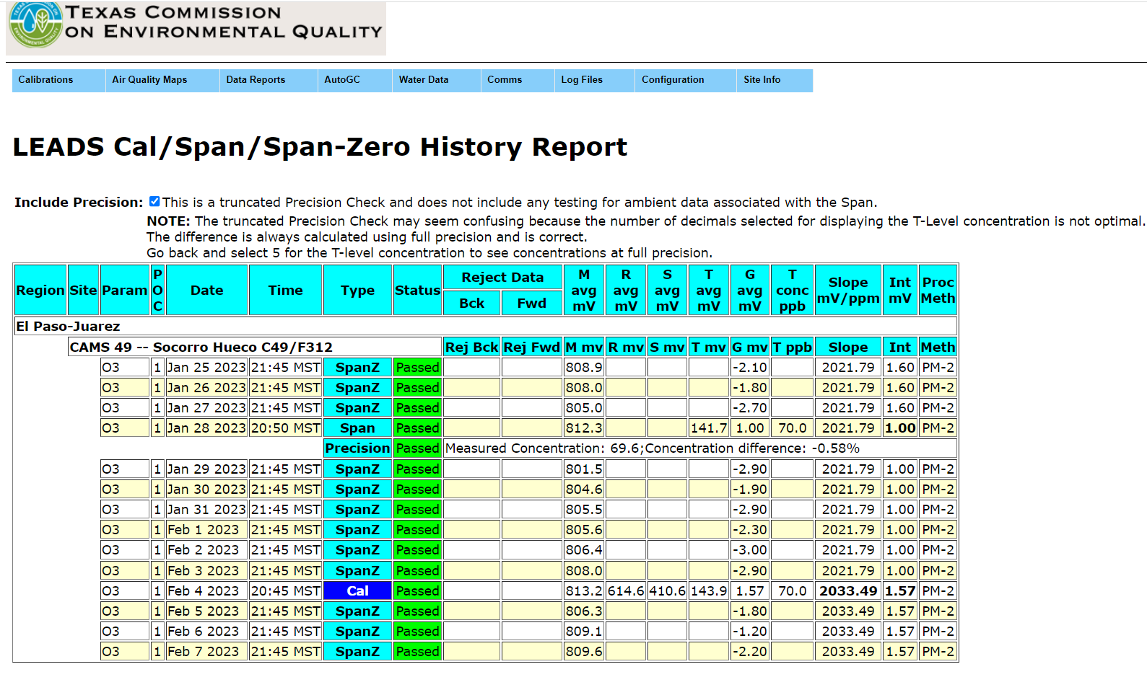
Quality Control Checks
Automated daily, weekly, and monthly checks on the continuous gaseous analyzers
Notes:
EPA requires a single point precision check; this is checked weekly when the automated span is performed.
Operator’s check the results of the automated QC results and the instruments response. They then would address any warning or failures of these checks.

Slide 10
Quality Control Checks
TCEQ performs Laboratory Control Checks (LCCs) twice a quarter, spaced 45 days apart.
Notes:
These checks are not required in the CFR or EPA guidance. TCEQ performs these checks to add another layer of quality control.
Gas standards for NO, SO2 and CO quality control checks are confirmed in the Cal Lab before they are sent to the field. Meet the concentration stated on the Certificate of Analysis (COA)

Slide 11
Flow Checks
Particulate Matter Samplers
Use verified orifices, manometers, thermometers, and barometers.
Perform checks around the same time each month to limit data loss.
TCEQ uses two audit kits.
  Monthly kit, a standard used for calibrations and flow checks
  Quarterly Kit, this kit is a second standard used to check the instrument.
Notes:
Particulate matter samplers are checked monthly, (30 days), and Quarterly
These kits are verified by the TCEQ Calibration Laboratory every year.
Kit must be in date to be used.
Verified against NIST traceable standards.

Slide 12
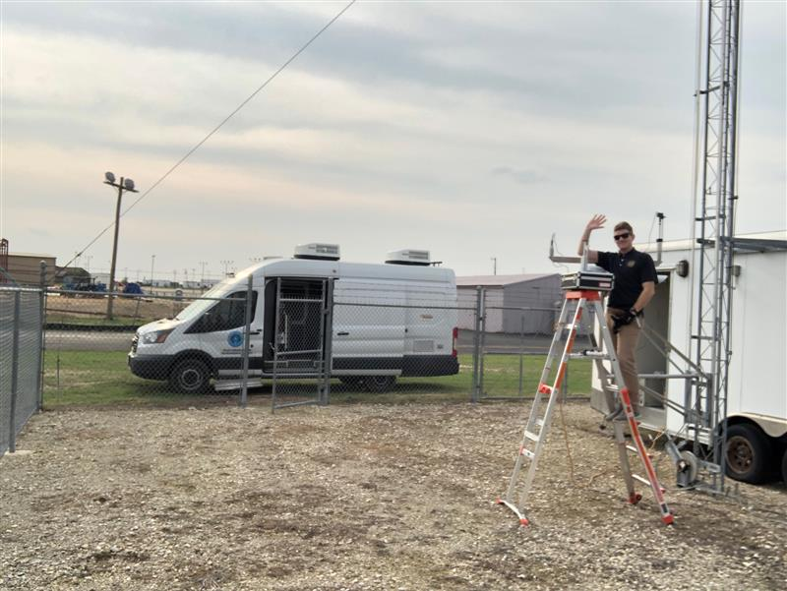
Audits
Field audits
  Flow, temperature, and pressure audits
Performance evaluation (PE) audits
Technical systems audits
Notes:
Field audits are performed using another set of standards then what is used for Monthly and Quarterly checks by operators. The work is also performed by staff that are not field operators.

Slide 13
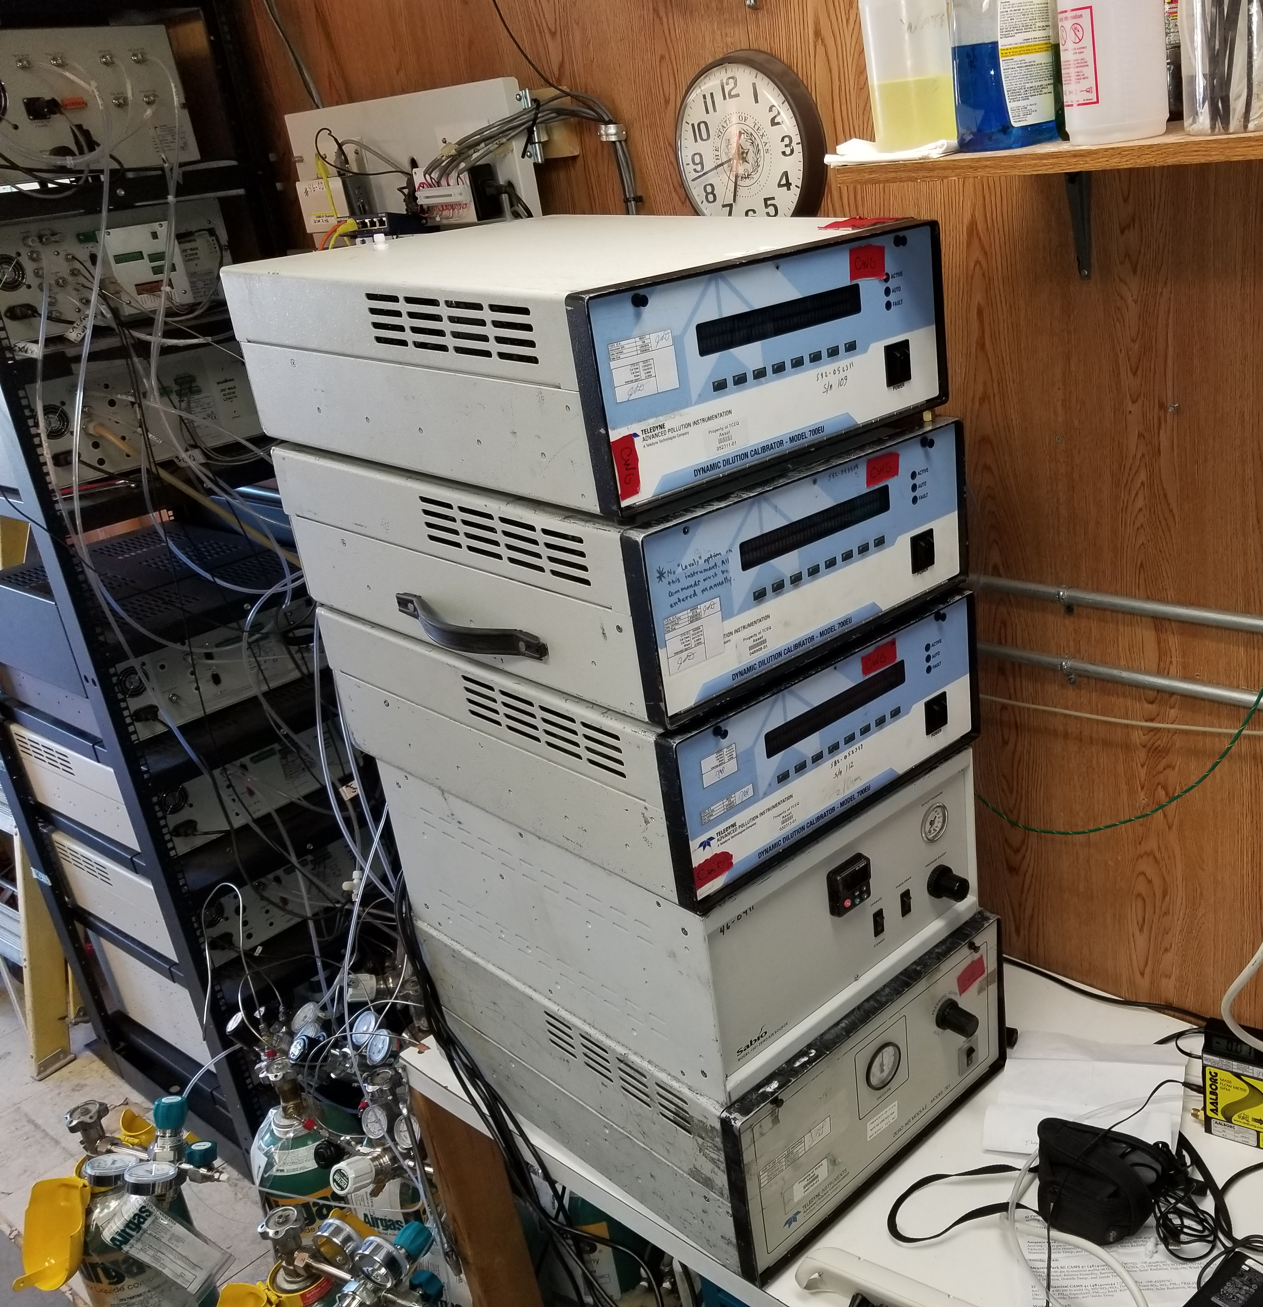
Performance Evaluations (PE) Audits
These are performed by a separate Section within TCEQ’s Monitoring Division.
This helps creates separation between operators and auditors.
A second complete set of audit equipment and gas standards are brought to the site.
Notes:
PE audits are more intense. They check the site analyzers across 5 different points.
TCEQ is also approved to perform National Performance Audit Program (NPAP) audits. This is an audit following EPA’s national program and requires the use of a different set of standards that what was used for the PE audit.

Slide 14
Questions?
Neal Penney, Manager
  Network Operations Section
  512-239-6342
  Neal.Penney@tceq.texas.gov

